Slide 1
Network Reference Models

Slide 2
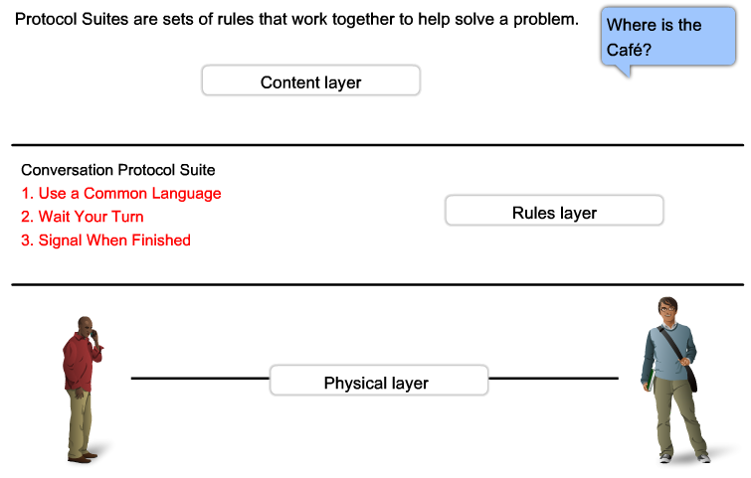
Reference Models

Slide 3
Reference Models
a framework (guideline) for network implementation and troubleshooting
divides complex functions into simpler components
Importance of reference model:
  Vendor interoperability “standardization”.
  Better understanding of data transfer
Reference model types :
  OSI (Open System Interconnection ).
  TCP/IP (DOD Model).
  Other Models.

Slide 4
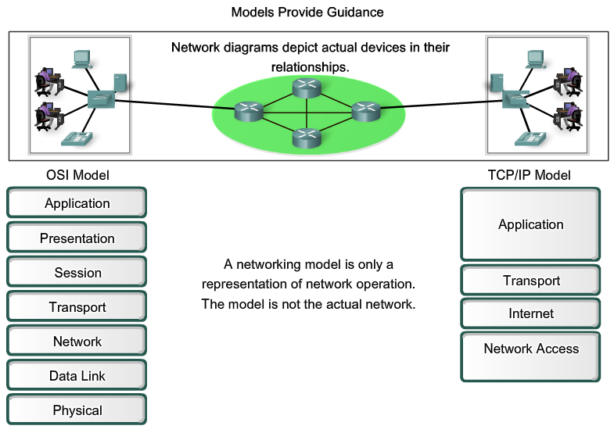
Reference Models

Slide 5
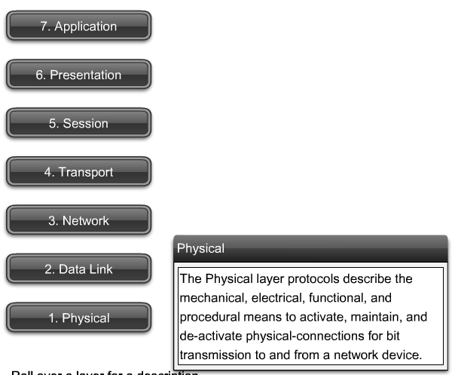
Reference Models

Slide 6
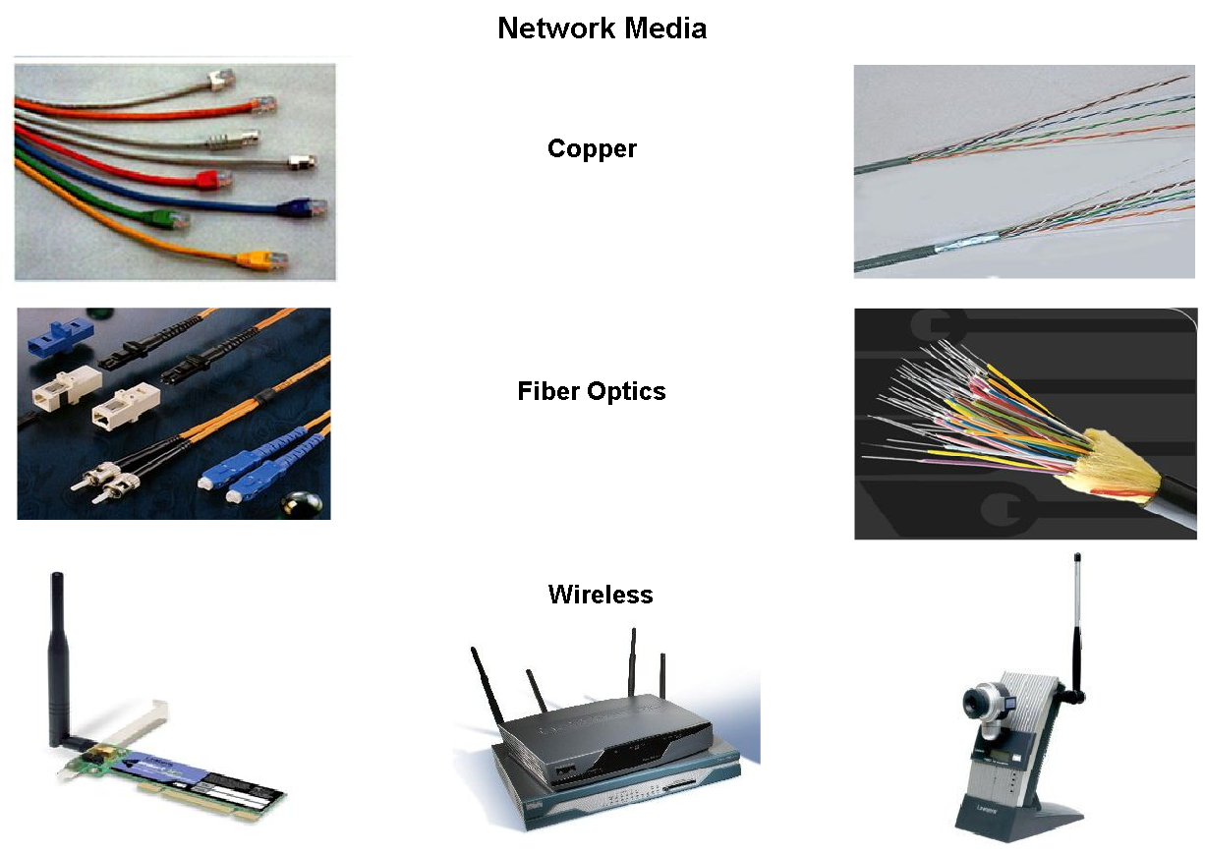
Network media

Slide 7
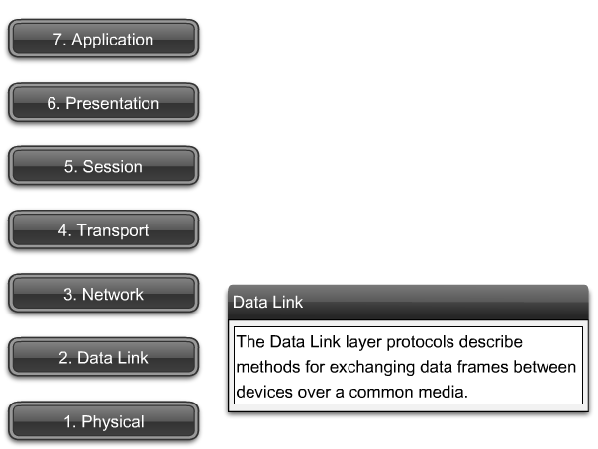
Reference Models

Slide 8
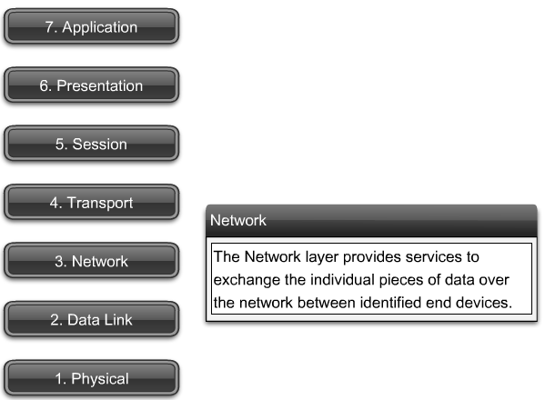
Reference Models

Slide 9
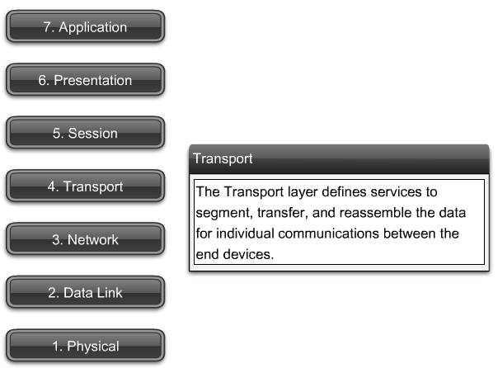
Reference Models

Slide 10
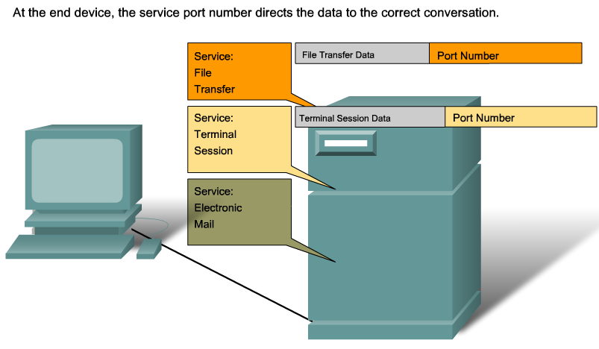
Reference Models

Slide 11
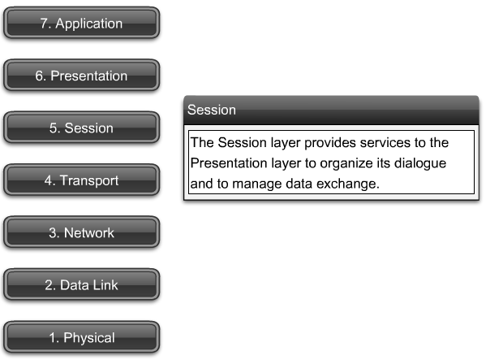
Reference Models

Slide 12
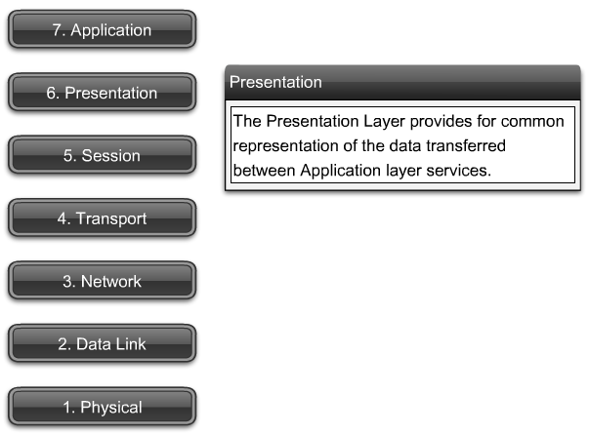
Reference Models

Slide 13
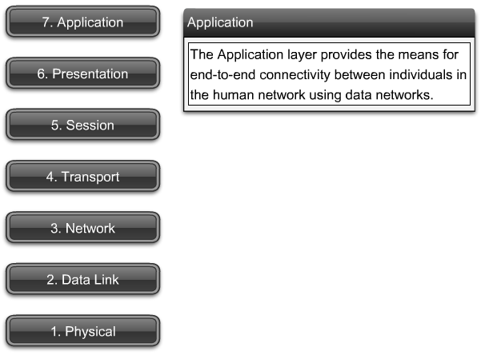
Reference Models

Slide 14
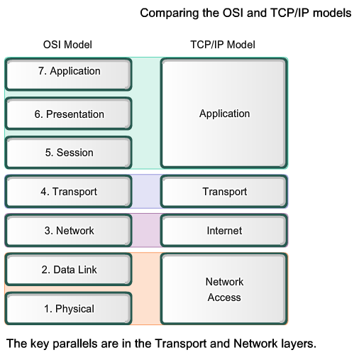
Reference Models

Slide 15
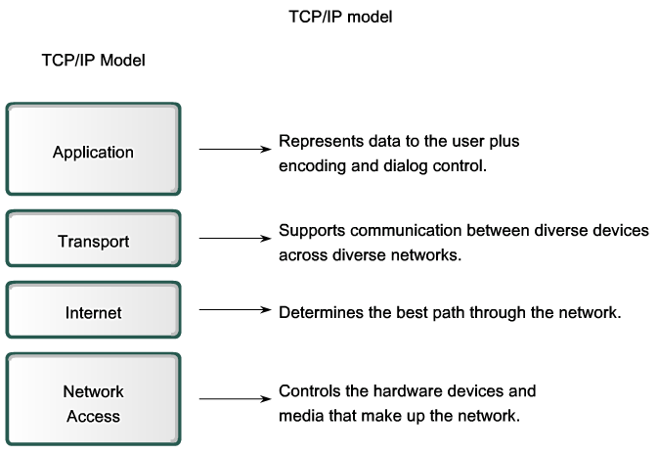
Reference Models

Slide 16
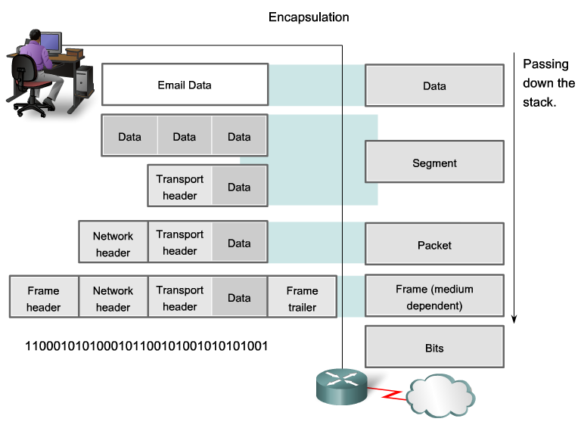
Reference Models

Slide 17
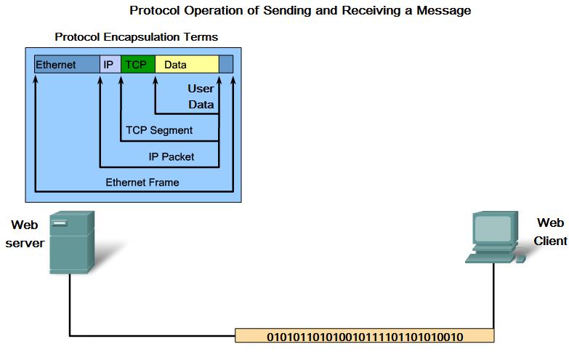
Reference Models

Slide 18
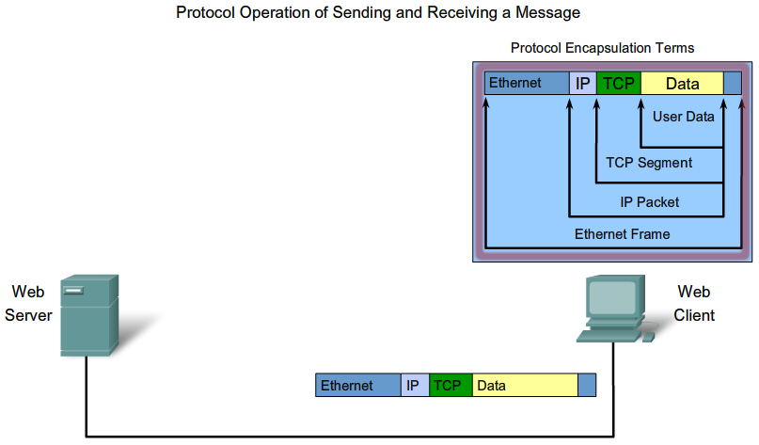
Reference Models

Slide 19
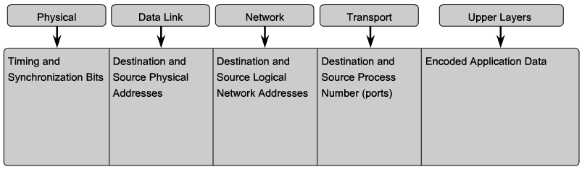
Reference Models

Slide 20
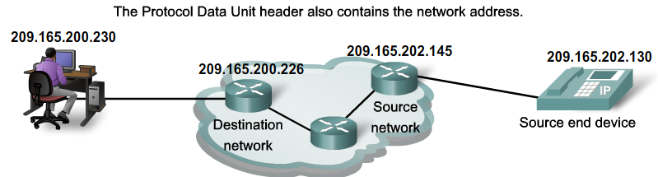
Reference Models

Slide 21
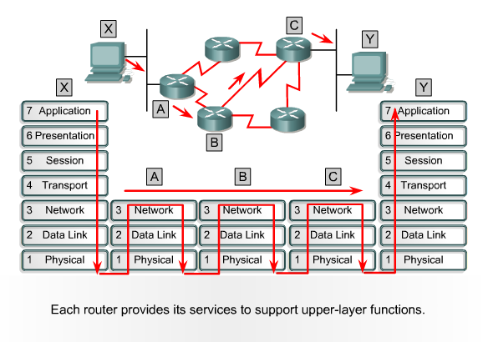
Transmission Example

